Slide 1
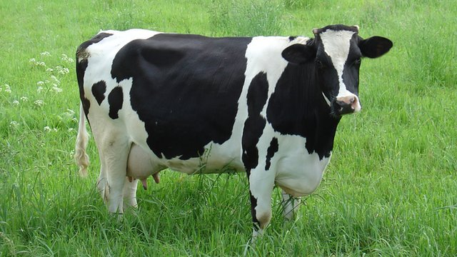
Abomasum
Dr. Ashraff Waleed

Slide 2
Abomasum
The abomasum unlike a ruminant's three forestomachs, the abomasum is a 'secretory stomach'. This means that cells in the abomasum wall produce enzymes and hydrochloric acid which hydrolyse proteins in the food and also in the microbes mixed in with the food.
causes
Mechanism of action
pattern
causes
Mechanism of action
pattern

Slide 3
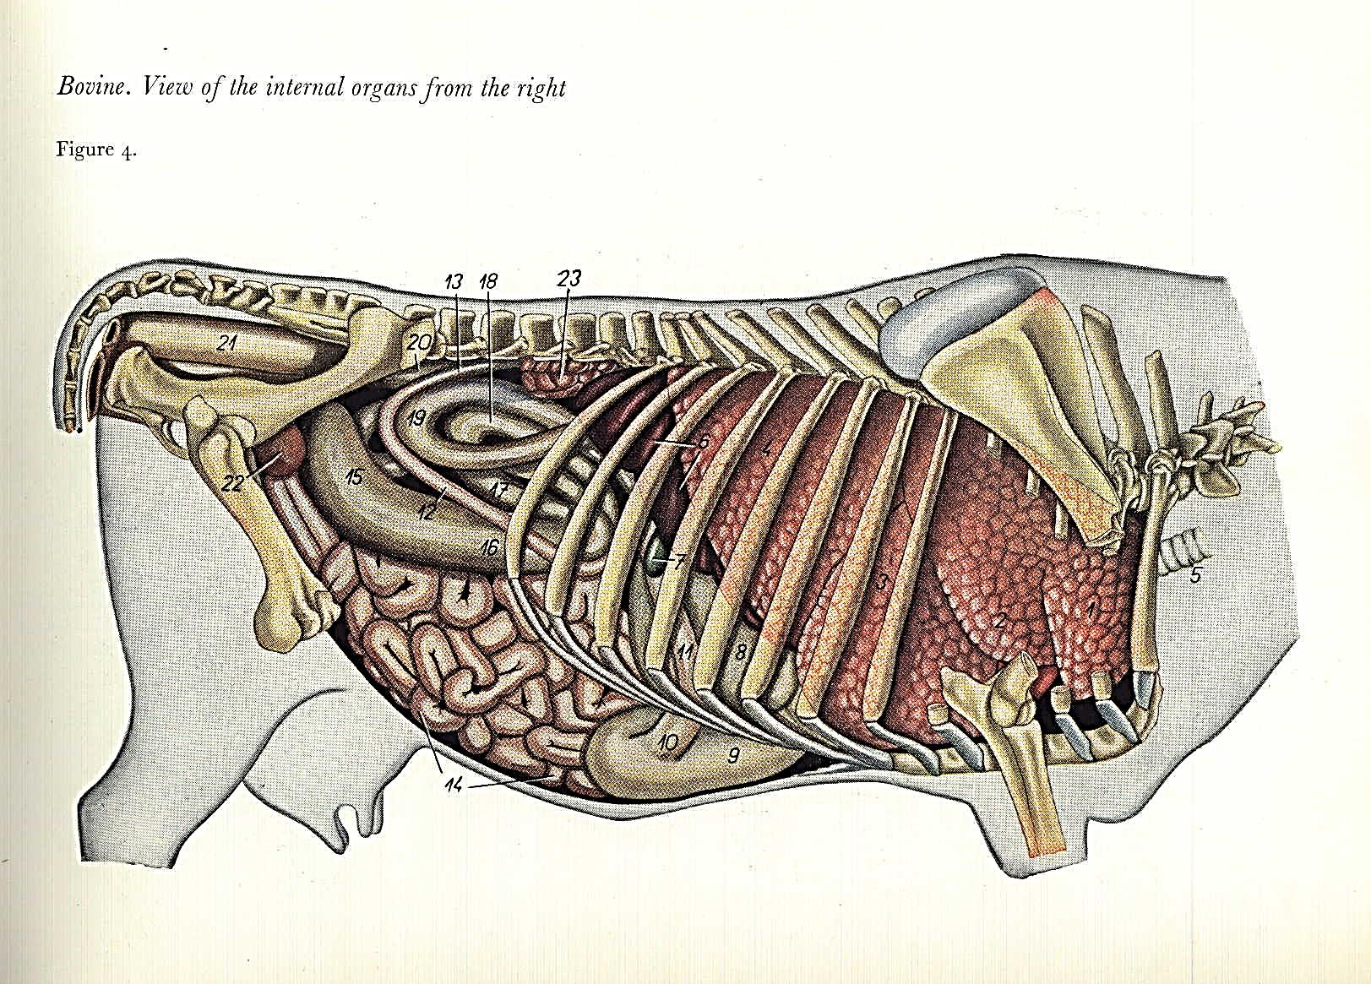
Abomasum

Slide 4
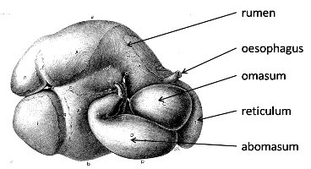
Abomasum
The range of surgical conditions include:
1-displacement
2-distension
3-torsion (volvulus)
4-ulceration
5-impaction
6-neoplasia
7-pylorospasm

Slide 5
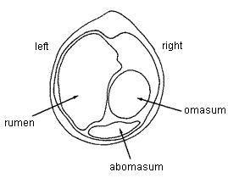
Abomasal displacement syndrome
●Three syndromes that involve movement of the abomasum are commonly recognized:
1-Left abomasal displacement (LDA)
2-Right abomasal dilation (RDA)
3-Right abomasal volvulus (RVA)
■Left displacements are significantly more common than either right dilation or volvulus and represent 85%-96% of all displacement conditions.

